Slide 1
CARAVANA FILIPINA
Fact-finding mission to the Philippines June 4 – 13, 2024
Presentation June 20, 2024
Meeting of the coalition of the Day of the Endangered Lawyer

Slide 2
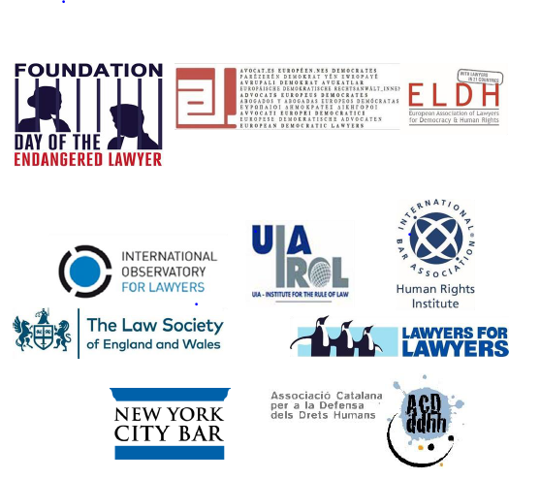
Participating organisations (10)

Slide 3
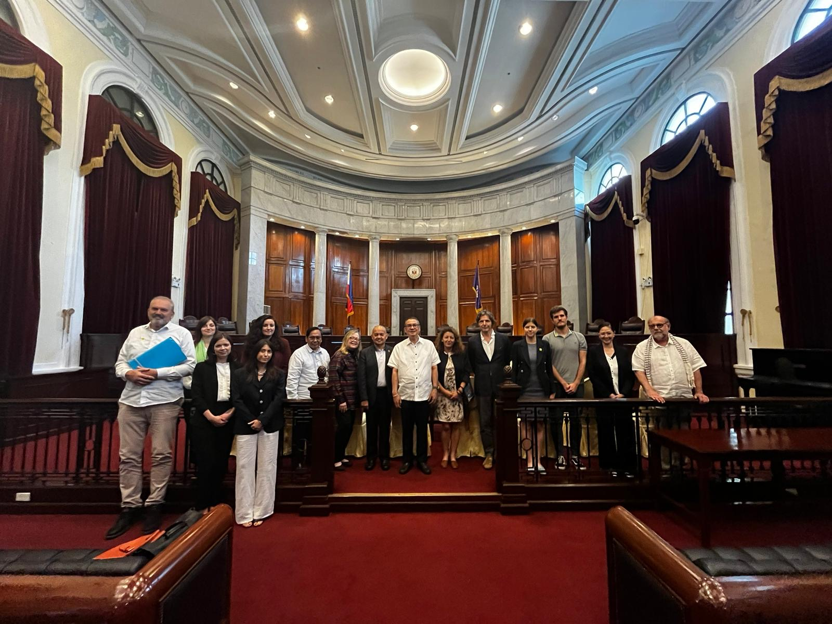
Participants (12)

Slide 4
Purpose FFM
Key aim is to investigate ATTACKS ON PHILIPPINE LAWYERS, PROSECUTORS, & JUDGES
Strengthen protections for Philippine judges, prosecutors, lawyers, and other legal professionals who, by performing their professional duties, have faced persecution, including extrajudicial killings, physical attacks and red tagging.
By enhancing such protections, the Caravana seeks to expand access to justice for legal professionals who have suffered violations of their rights, as well as for all people of the Philippines.
Side goals, e.g. get in touch with victims and relatives, allow victims and relatives to meet, supporting NUPL client groups (e.g. Jeepney drivers, a squatting community), assisting in a recruiting event.

Slide 5
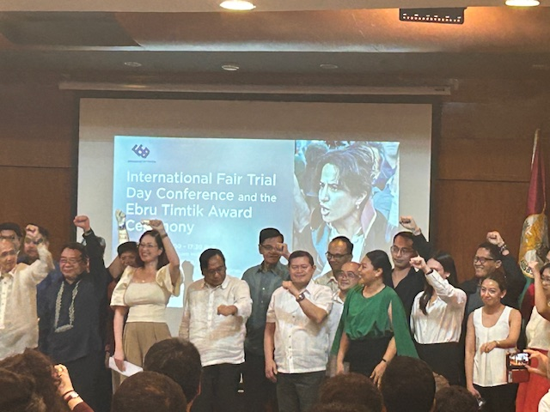
Host: National Union of Peoples’ Lawyers, winner of the 2024 Ebru Timtik Award

Slide 6
Schedule
4 June Manilla Introduction
5-8 June - Team 1 Manilla/Baguio Interviews
5-9 June - Team 2 - Iloilo/Cebu Interviews
9-12 June - Manilla Interviews, visits Supreme Court + Commission on HR
13 June Press statement and press conference
14 June International Fair Trial Day
(together with partners IBP, UP/Law School and NUPL).
While visiting Metro Manila, Cordillera, Iloilo, and Cebu, we were gathering testimonies from Lúzon, Visayas, and Mindanao.

Slide 7
Preliminary Findings
Header of Press statement: “CULTURE OF IMPUNITY PREVAILS”
We “observed an alarming pattern of violations of the legal protections to which Philippine legal professionals are entitled. We documented first-hand accounts of judges and lawyers who have suffered attacks since 2016 to the present day, ranging from harassment, intimidation, surveillance, threats, and red-tagging, to physical assault, arbitrary detention and prosecution, and extrajudicial killings – in other words, assassinations.
In addition, the delegation has documented the accounts of victims’ family members and legal representatives, and has met with representatives of a wide range of Philippine organisations and institutions which have an interest in the independence and the safety and security of the country’s legal professionals.”
The members of the Caravana Filipina made four preliminary findings:
(1) the unprecedented scale of the attacks on legal professionals
(2) the culture of impunity & climate of fear
(3) red-tagging; and
(4) the repression of civil society and freedom of speech.

Slide 8
(1) the unprecedented scale of the attacks on legal professionals
The Philippines has long been recognised as one of the most dangerous countries in the world for legal professionals.
In the 15-year period from September 15, 2007 to present, the National Union of Peoples’ Lawyers (NUPL) documented 90 prima facie work or profession related killings of lawyers, prosecutors, and judges.
In addition to these senseless deaths, there have been many other cases of attempted assassination, as well as countless instances of other forms of attacks.
This disturbing pattern of assaults on legal professionals is continuing. Only a few days ago, on 10 June, Prosecutor Eleanor “Ning” P. Dela Peña was assassinated on her way home from work. While the circumstances are still emerging, the Caravana honours Prosecutor Dela Peña for her commitment to justice, and trusts that her attacker will be brought to justice.

Slide 9
(2) The Culture of Impunity & Climate of Fear
The scale of the attacks on Philippine legal professionals is exacerbated by the pervasive culture of impunity and the prevailing climate of fear.
Out of all of the cases discussed in the Caravana’s interviews and meetings with lawyers, judges, and others, there was none where the perpetrator has been identified, apprehended, and prosecuted. The delegation’s discussions with the Commission on Human Rights confirmed that many of the killings result in impunity due to a failure to identify the perpetrators. The interviews conducted by the Caravana have left the delegation with the impression that many cases are prematurely labelled as "cold cases" without thorough and effective investigations

Slide 10
(3) “Red-Tagging”
During its discussions, the delegation found "red-tagging" to be a significant factor in attacks on legal professionals. For example, in the majority of cases examined, the victims had been subjected to red-tagging shortly before they were killed or attacked.
In vicious “smear campaigns” on social media and in public spaces, lawyers are often labelled as “communist rebels” or "terrorists" merely for fulfilling their legitimate professional duties and defending the oppressed, the poor, and the disadvantaged.
This frequently stems from identifying lawyers with their clients or their clients’ causes, in blatant violation of the U.N. Basic Principles on the Role of Lawyers. In other cases, red-tagging is used to target lawyers in an effort to de-legitimise the groups that they represent, and even to render those groups defenceless.

Slide 11
(4) Repression of Civil Society and Freedom of Speech
The delegation has also noted a trend of targeting NGOs and community activists with accusations of terrorism, terrorist financing, and other non-bailable offences. It is deeply troubling that community organisations which provide vital services for the poorest and most disadvantaged sectors of Philippine society are being criminalised through sweeping, unsubstantiated allegations. The delegation heard concerning reports of military deployment to protect private extraction and development projects and the displacement of indigenous and local peoples and violations of their rights.
The delegation has also received reports of attacks on Philippine journalists and is concerned about the safety and security of journalists and the independence of the media. The legal profession and the profession of journalism are complementary and symbiotic. Neither can survive without the other.

Slide 12
Further actions
Finalizing the documentary made by Jacco Groen, an experienced film maker who has made previous HR related documentaries in the PH
Preparing FFM report; asking response from authorities to certain findings and/or
Sharing final report and distribute this widely
Continuous monitoring of the situation in the PH
Ready for rapid response
Other type of actions: ICC case, support funding efforts NUPL
Prepare for Caravana Filipina 2026?

